Slide 1
Capacity-building for Internally-driven Development: Sharing of Poverty Reduction Experiences
Dr Junaidu A. Maina
Danwaire Farms Ltd

Slide 2
Introduction
According to National Bureau of Statistics (2018-19 household survey)
40% Nigeria’s population or 83m live at or below the poverty line, The national poverty line was established at <N137,430.00
Majority of poor are in Rural areas with Urban areas faring better.
That majority of the poor live in large families, with only around 18 percent living in households of four or less.
Access to education is an important factor in poverty outcomes, with poverty concentrated in households with primary education or less.
And
concluded that “Majority of the poor work in agriculture and farm related businesses.’’

Slide 3
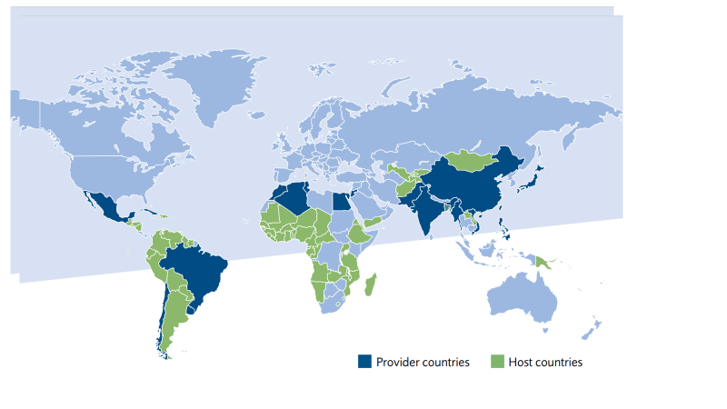
Poverty Reduction Projects
North-South Cooperation has been the traditional model for catalyzing agricultural development. South-South and Triangular Cooperation (SSC) was introduced to complement that model. SSC is partnerships between two or more developing countries in collaboration with a third partner, typically a developed/ donor/emerging economy and/or multilateral organization

Slide 4
FAO promoted South-South and Triangular Cooperation (SSC)
Objective of SSC was to overcome common challenges and achieve food security, poverty reduction and the sustainable management of natural resources.
SSC 4 Pillars
Facilitate the exchange and uptake of development solutions
Promote platforms for knowledge networking
Mobilize upstream policy support
Foster an enabling environment for partnerships and strategic alliances and mobilization of adequate and sustainable resources.
SSC was based on a concept of Host country, Provider Country and FAO.
Nigeria keyed into SSC as Host country and China as Provider

Slide 5
Nigeria-China, South-South Cooperation Project
Nigeria committed $500m, China provided experts and technology with FAO as facilitator.
1st Phase (2003-2007) focused on;
Forestry, aquaculture, horticulture, animal husbandry and crop production.
Main achievements were;
Rice-Fish-Culture (cage culture technology),
Poultry- increase in vitamin content of eggs and
Beekeeping.
2nd Phase (2009-2015);Demand driven with individual States’ requesting for specific types of Agric support in areas of strengthening capacities of farmers, processors, farm managers and extension staff.
Main achievements were
consolidating achievement of 1st Phase
increased SSP capacity building in various aspects of Agriculture
constructions of small earth dams for irrigations

Slide 6
Skill gaps and Capacity building for internally driven development for SSPs
Addressing skill gaps for advancement of internally driven poverty reduction.
1. Climate change (CC) & Climate-smart agriculture (CSA). SSPs understand the effect of CC on their farms by experiencing declining soil fertility, poor yields, changes in rainfall pattern with increased frequency of flooding etc.
understanding the concept of ‘climate-smart’ agriculture.
introduction of climate-smart technologies to compliment indigenous knowledge .
sustainable land use and climate-smart’ agriculture (livestock, fisheries and forestry)
2. Improved Livestock husbandry methods: chicken, small ruminants and pigs are inflation free money safe boxes for SSPs (Piggy Bank). Rearing livestock the only viable dry season agricultural activities in areas where no water bodies exist.
developing small holder business models
mitigation against diseases and CC induced conflicts.
promoting crop/livestock enterprises

Slide 7
Skill gaps and Capacity building for internally driven development for SSPs cont’d
3. Post harvest and processing
good agricultural practices & reduction in post harvest wastages
maintaining quality standards and Public health regulations in processing
understanding exports standards for premium prices.
organic agriculture
4. Farmer organisation and Financial management
formation of producer associations/cooperatives
negotiation skill for better prices from aggregators, middlemen etc
how to access funds from banks and financial institutions for small scale operations etc

Slide 8
Skill gaps and Capacity building for internally driven development for SSPs cont’d
5. Agri-entrepreneurs and exporters; in supply chain, SSPs produce small quantities, sell to aggregators who sell to big markets/exporters.
understanding the peculiarities of export markets.
guidance in appropriate applications of agro pesticides etc
maintenance of export standards
how private agri-businesses are adapting to climate change (e.g. seed supply, technologies, supply chain management etc)
6. Gender mainstreaming; women play critical roles in all agricultural production, processing and family nutrition.
inclusive governance –women voice in decision making (commodities processing, storage, pricing etc)
general home management
adult literacy

